Slide 1

WELCOME
CAPTAIN

Slide 2
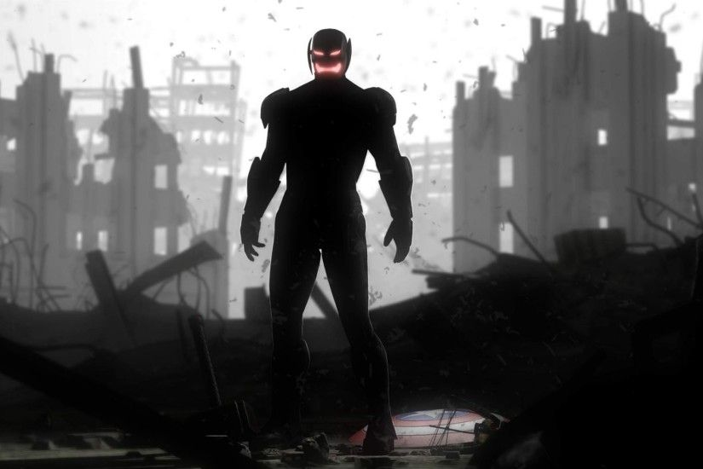

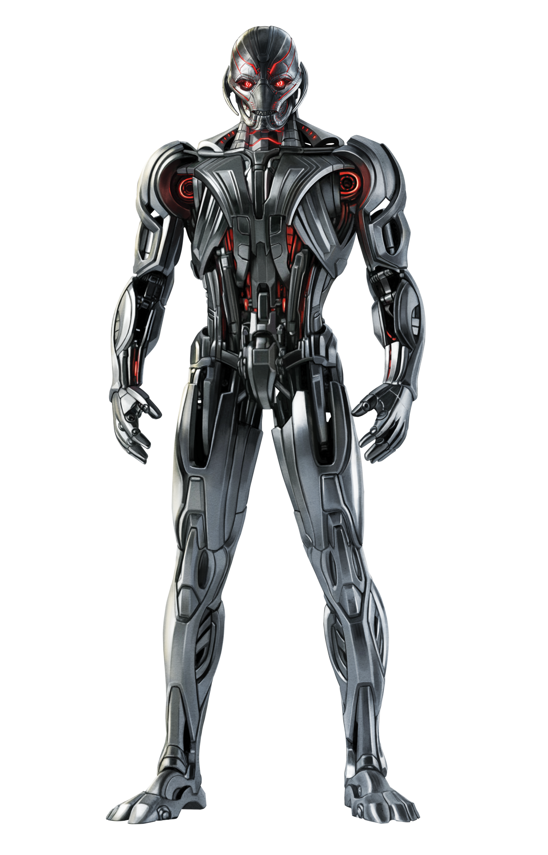
Target scanned
ULTRON
Type: Supervillain
Make: Adamantium
POWERS
Superhuman strength
Energy
Speed
Blasts of energy:
ENCEPHALO-RAY

Slide 3
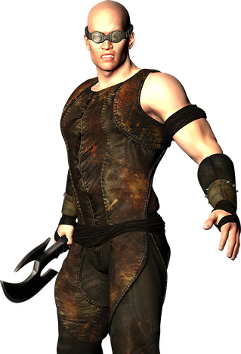
TARGET NEAR

Slide 4
TARGET NEAR
USE GROUND COMBAT
TARGET ARMOUR
EQUIPPED
Fight style AMERICAN STYLE JUDO

Slide 5
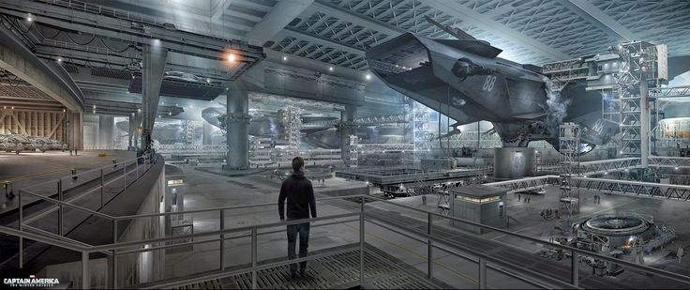
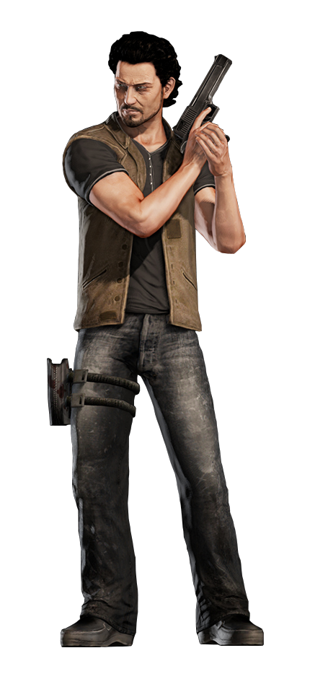
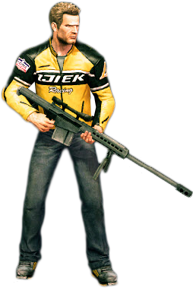
TARGETS FAR

Slide 6
TARGETS FAR
25m
10m
THROW SHIELD
60m
30m

Slide 7


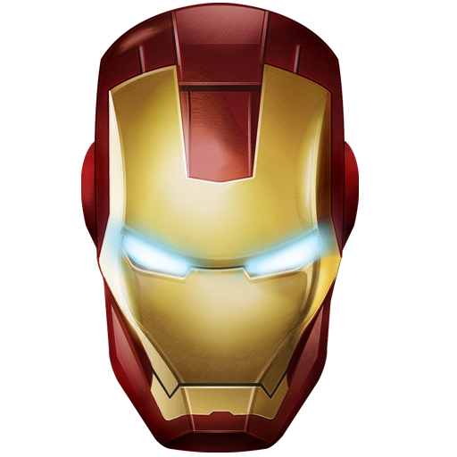
NEED HELP

Slide 8
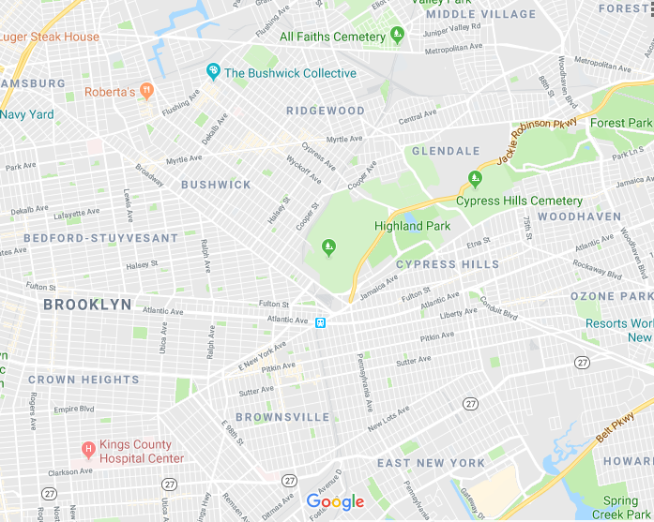



NEED HELP
ENEMY
YOU
AVENGER

Slide 9

NEED HELP
ENEMY
YOU
ALERT SENT
AVENGER

Slide 10
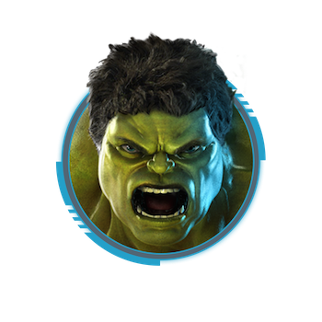
HULK SHOT

Slide 11

HULK SHOT
YOU
ENEMY
AVENGER

Slide 12

HULK SHOT
ALERT SENT
YOU
ENEMY
AVENGER

Slide 14
ENEMY
YOU
AVENGER

Slide 15
YOU
ENEMY
AVENGER

